Slide 1
Life expectancy prediction
By Trent Casillas

Slide 2
outline
Generalized Capstone Timeline:
Motivation
Dataset Introduction
Exploratory Data Analysis
Feature Correlation
Top Positive and Negative correlated features to Life Expectancy and correlated pairs overall
Regression Methods and Evaluation
Models include: Ridge Regression, Gradient Boosting , Robust (Thiel-sen) Regression
Clustering and Evaluation
K-means, Mean-Shift
Mixed Effect Model Evaluation
Check ICC
Run Random Intercepts, Random Slopes, Random Intercepts and Slopes Models
Compare best model to Regression Methods
Conclusions
Takeaways and further studies

Slide 3
Motivation and purpose
Predict life expectancy by looking at the positive and negatively correlated factors to improve life quality
Try to discern any differences between countries groupings
Serves as an example for countries to assess to improve life expectancy for their citizens.
Notes:
the social sciences specialization using linear regression methods , clustering exercises , and mixed effects models.

Slide 4
Data set

Slide 5
Dataset information and cleaning
My data is from The World Health Organization and United Nations website, Life Expectancy expresses the results of 193 countries for life expectancy with 2938 rows for 20 different features columns spanning from 2000-2015 with 2563 missing values.
The features vary from whether country demographics such as Population, GDP, Total Expenditure spend on health to population statistics such immunizations and mortality rates along with BMI, Alcohol Consumption, and years of schooling.
The data cleaning included removed 1100 removed between GDP(448) and Population,(652),
818 values replaced with missing respective country means.
645 replaced by the mean related to the status of the country.
 | Country | Year | Status | Life Expectancy | Adult Mortality | Infant Deaths | Alcohol | Percent Expenditure | Hep B | Measles | BMI | U-5 Deaths | Polio | Total Expenditure | Diphtheria | HIV/AIDS | GDP | Population | Thinness 10-19 | Thinness 5-9 | Income Composition | Schooling
0 | Afghanistan | 2015 | Developing | 65 | 263 | 62 | 0.01 | 71.279624 | 65 | 1154 | 19.1 | 83 | 6 | 8.16 | 65 | 0.1 | 584.25921 | 33736494 | 17.2 | 17.3 | 0.479 | 10.1
1 | Afghanistan | 2014 | Developing | 59.9 | 271 | 64 | 0.01 | 73.523582 | 62 | 492 | 18.6 | 86 | 58 | 8.18 | 62 | 0.1 | 612.696514 | 327582 | 17.5 | 17.5 | 0.476 | 10
2 | Afghanistan | 2013 | Developing | 59.9 | 268 | 66 | 0.01 | 73.219243 | 64 | 430 | 18.1 | 89 | 62 | 8.13 | 64 | 0.1 | 631.744976 | 31731688 | 17.7 | 17.7 | 0.47 | 9.9
3 | Afghanistan | 2012 | Developing | 59.5 | 272 | 69 | 0.01 | 78.184215 | 67 | 2787 | 17.6 | 93 | 67 | 8.52 | 67 | 0.1 | 669.959 | 3696958 | 17.9 | 18 | 0.463 | 9.8
4 | Afghanistan | 2011 | Developing | 59.2 | 275 | 71 | 0.01 | 7.097109 | 68 | 3013 | 17.2 | 97 | 68 | 7.87 | 68 | 0.1 | 63.537231 | 2978599 | 18.2 | 18.2 | 0.454 | 9.5
5 | Afghanistan | 2010 | Developing | 58.8 | 279 | 74 | 0.01 | 79.679367 | 66 | 1989 | 16.7 | 102 | 66 | 9.2 | 66 | 0.1 | 553.32894 | 2883167 | 18.4 | 18.4 | 0.448 | 9.2
6 | Afghanistan | 2009 | Developing | 58.6 | 281 | 77 | 0.01 | 56.762217 | 63 | 2861 | 16.2 | 106 | 63 | 9.42 | 63 | 0.1 | 445.893298 | 284331 | 18.6 | 18.7 | 0.434 | 8.9
7 | Afghanistan | 2008 | Developing | 58.1 | 287 | 80 | 0.03 | 25.873925 | 64 | 1599 | 15.7 | 110 | 64 | 8.33 | 64 | 0.1 | 373.361116 | 2729431 | 18.8 | 18.9 | 0.433 | 8.7
8 | Afghanistan | 2007 | Developing | 57.5 | 295 | 82 | 0.02 | 10.910156 | 63 | 1141 | 15.2 | 113 | 63 | 6.73 | 63 | 0.1 | 369.835796 | 26616792 | 19 | 19.1 | 0.415 | 8.4
9 | Afghanistan | 2006 | Developing | 57.3 | 295 | 84 | 0.03 | 17.171518 | 64 | 1990 | 14.7 | 116 | 58 | 7.43 | 58 | 0.1 | 272.56377 | 2589345 | 19.2 | 19.3 | 0.405 | 8.1

Slide 6
Feature list
Country- Country Year- Year Status- Developed or Developing status Life Expectancy- Age(years) Adult Mortality- Adult Mortality Rates of both sexes(probability of dying between 15&60 years per 1000 population) Infant Deaths- Number of Infant Deaths per 1000 population Alcohol- Alcohol, recorded per capita (15+) consumption (in litres of pure alcohol) Percent Expenditure- Expenditure on health as a percentage of Gross Domestic Product per capita(%) Hep B- Hepatitis B (HepB) immunization coverage among 1-year-olds(%) Measles- number of reported measles cases per 1000 population BMI- Average Body Mass Index of entire population U-5 Deaths- Number of under-five deaths per 1000 population Polio- Polio(Pol3) immunization coverage among 1-year-olds(%) Total Expenditure- General government expenditure on health as a percentage of total government expenditure(%) Diphtheria- Diphtheria tetanus toxoid and pertussis (DTP3) immunization coverage among 1-year-olds(%) HIV/AIDS- Deaths per 1000 live births HIV/AIDS(0-4 years) GDP- Gross Domestic Product per capita(in USD) Population- Population Thinness 10-19- Prevalence of thinness among children and adolescents for Age 10 to 19 Thinness 5-9(%)- Prevalence of thinness among children for Age 5 to 9(%) Income Composition-Human Development Index in terms of income composition of resources(0-1) Schooling- Number of years of Schooling
Notes:
Add data head here , take out comment make slide for data features

Slide 7
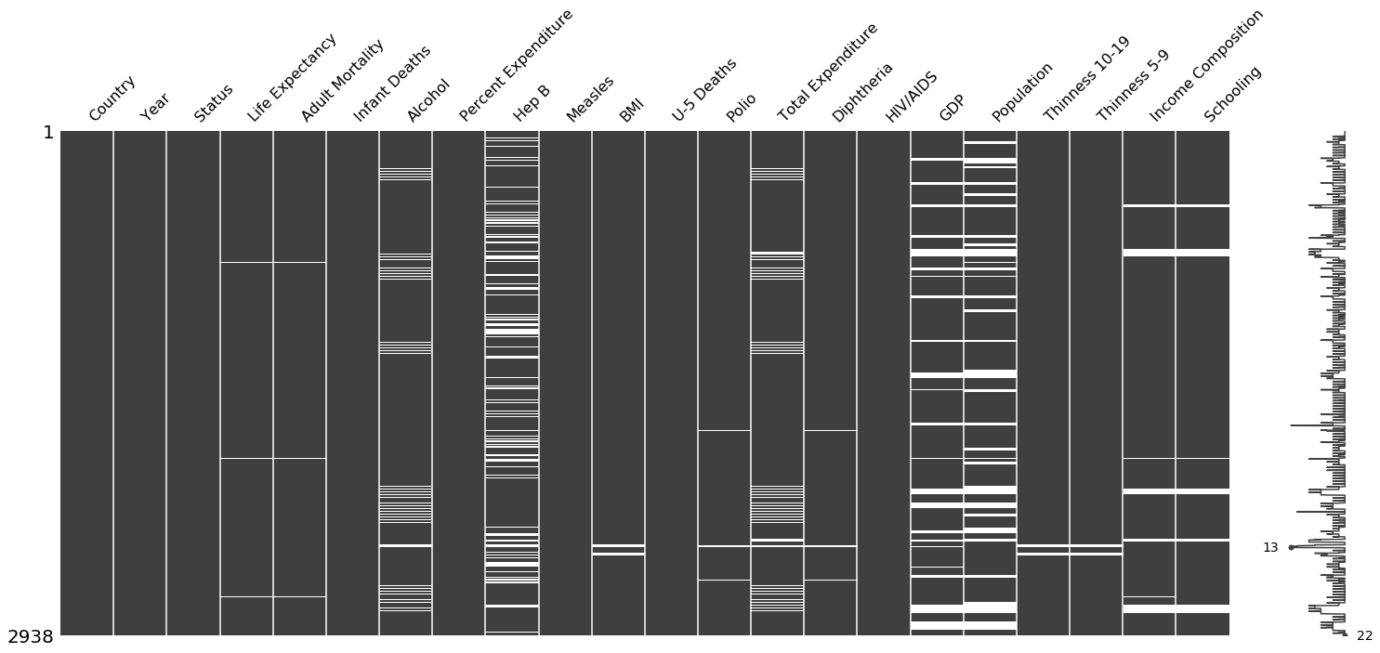
Dataset
Feature | Year | Life Expectancy | Adult Mortality | Infant Deaths | Alcohol | Percent Expenditure | Hep B | Measles | BMI | U-5 Deaths | Polio | Total Expenditure | Diphtheria | HIV/AIDS | GDP | Population | Thinness 10-19 | Thinness 5-9 | Income Composition | Schooling
count | 2938 | 2928 | 2928 | 2938 | 2744 | 2938 | 2385 | 2938 | 2904 | 2938 | 2919 | 2712 | 2919 | 2938 | 2490 | 2.29E+03 | 2904 | 2904 | 2771 | 2775
mean | 2007.51872 | 69.224932 | 164.796448 | 30.303948 | 4.602861 | 738.251295 | 80.940461 | 2419.59224 | 38.321247 | 42.035739 | 82.550188 | 5.93819 | 82.324084 | 1.742103 | 7483.15847 | 1.28E+07 | 4.839704 | 4.870317 | 0.627551 | 11.992793
std | 4.613841 | 9.523867 | 124.292079 | 117.926501 | 4.052413 | 1987.914858 | 25.070016 | 11467.2725 | 20.044034 | 160.445548 | 23.428046 | 2.49832 | 23.716912 | 5.077785 | 14270.1693 | 6.10E+07 | 4.420195 | 4.508882 | 0.210904 | 3.35892
min | 2000 | 36.3 | 1 | 0 | 0.01 | 0 | 1 | 0 | 1 | 0 | 3 | 0.37 | 2 | 0.1 | 1.68135 | 3.40E+01 | 0.1 | 0.1 | 0 | 0
25% | 2004 | 63.1 | 74 | 0 | 0.8775 | 4.685343 | 77 | 0 | 19.3 | 0 | 78 | 4.26 | 78 | 0.1 | 463.935626 | 1.96E+05 | 1.6 | 1.5 | 0.493 | 10.1
50% | 2008 | 72.1 | 144 | 3 | 3.755 | 64.912906 | 92 | 17 | 43.5 | 4 | 93 | 5.755 | 93 | 0.1 | 1766.9476 | 1.39E+06 | 3.3 | 3.3 | 0.677 | 12.3
75% | 2012 | 75.7 | 228 | 22 | 7.7025 | 441.534144 | 97 | 360.25 | 56.2 | 28 | 97 | 7.4925 | 97 | 0.8 | 5910.80634 | 7.42E+06 | 7.2 | 7.2 | 0.779 | 14.3
max | 2015 | 89 | 723 | 1800 | 17.87 | 19479.91161 | 99 | 212183 | 87.3 | 2500 | 99 | 17.6 | 99 | 50.6 | 119172.742 | 1.29E+09 | 27.7 | 28.6 | 0.948 | 20.7
Population and GDP will be dropped due to discrepancies with the data.
Fill in remaining missing with country mean where applicable
In other cases, fill in data with associated country status mean.

Slide 8
3 Sigma OUtliers
Adult Mortality 99 Percentile 675.2 Max 723.0
Infant Deaths 99th Percentile 1307.0 Max 1800
Alcohol 99th Percentile 15.07 Max 17.87
Percent Expenditure 99th Percentile 15357.4 Max 19479.9
Percent Expenditure Measles 99th Percentile 111472.7 Max 212183
BMI 99th Percentile 76.7 Max 87.3
U-5 Deaths 99th Percentile 1807.0 Max 2500
Total Expenditure 99th Percentile 16.2 Max 17.6
HIV/AIDS 99th Percentile 42.1 Max 50.6
Thinness 10-19 99th Percentile 27.0 Max 27.7
Thinness 5-9 99th Percentile 27.9 Max 28.6
Schooling 99th Percentile 20.3 Max 20.7

Slide 9
Exploratory data analysis

Slide 10
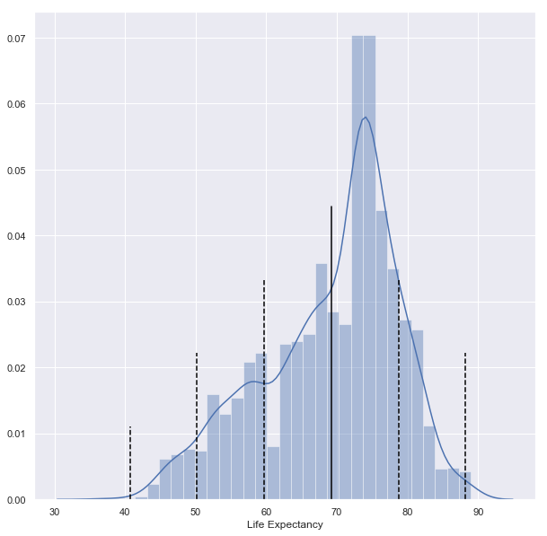
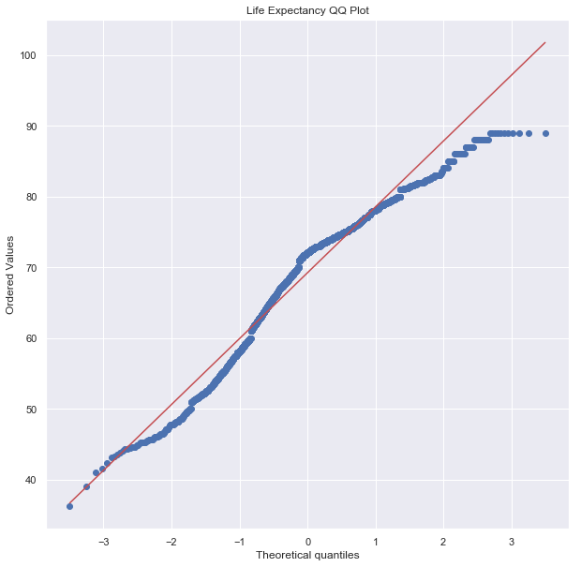
Life expectancy
Normal Fit : 0.9566084742546082,
P-value: 9.622531605232346e-29
Maximum value 89.0 years
Mean 69.2 years
Minimum 36.3 years
Standard Deviation 9.5 years

Slide 11
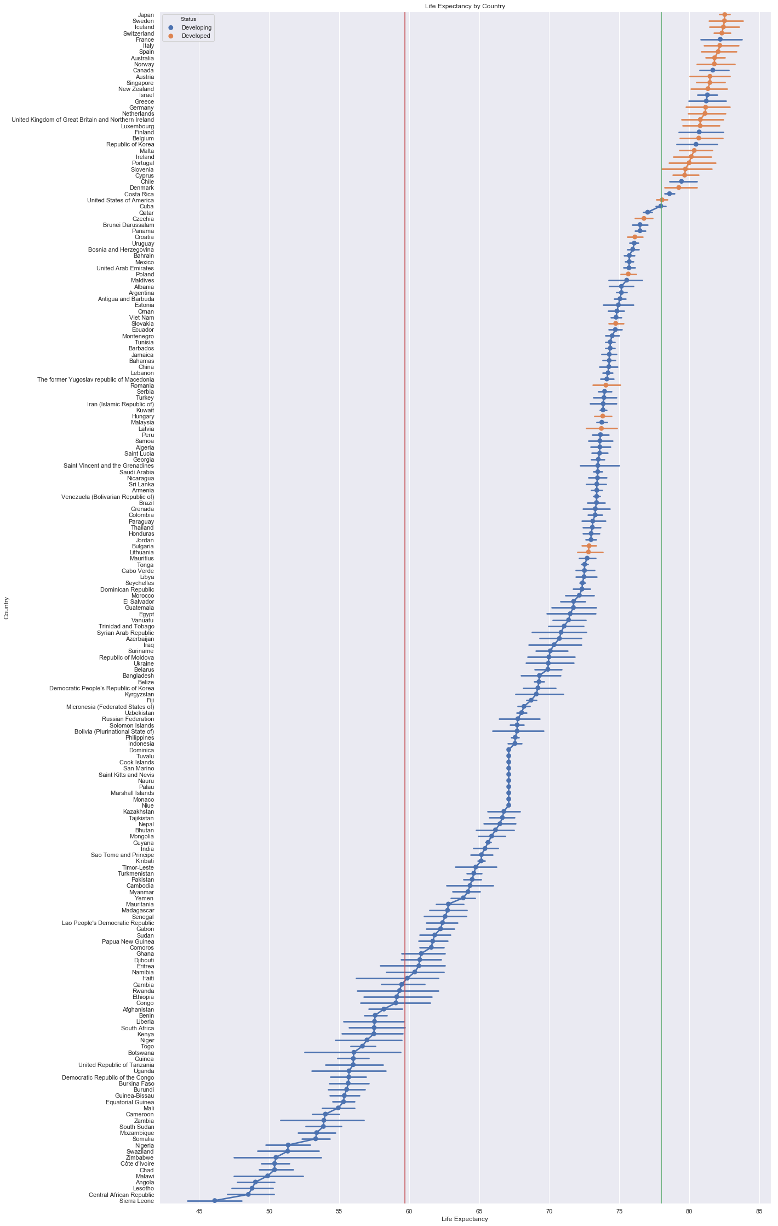
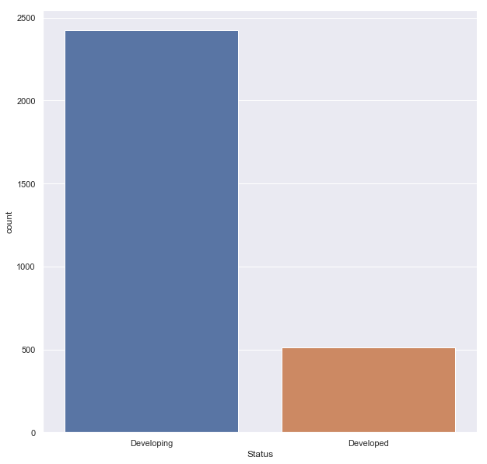
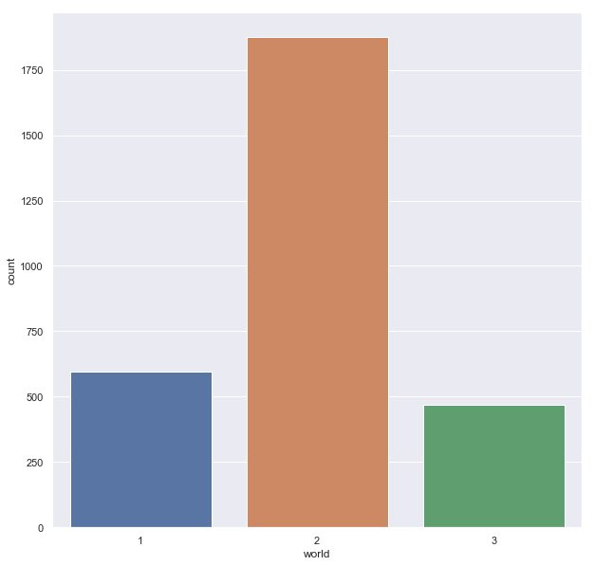
Country categories
Country Status:
Developing: 82.6% Developed: 17.4%
World Feature:
3rd World:16.0% 2nd World:63.8% 1st World: 20.3%
3rd World is below 60 and 1st world is above 78

Slide 12
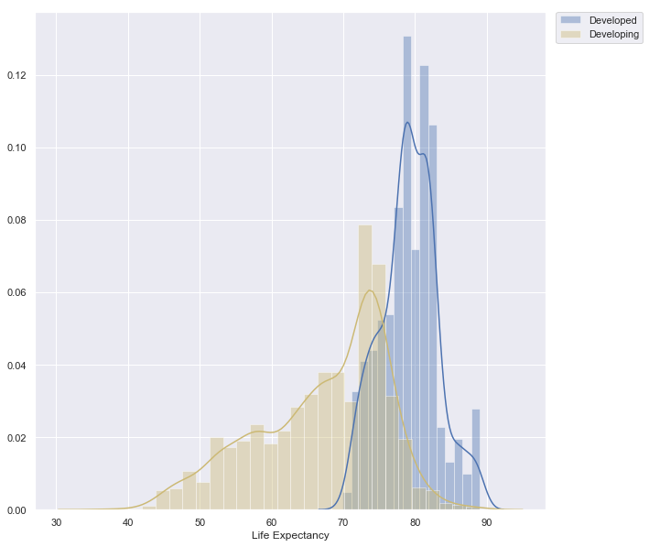
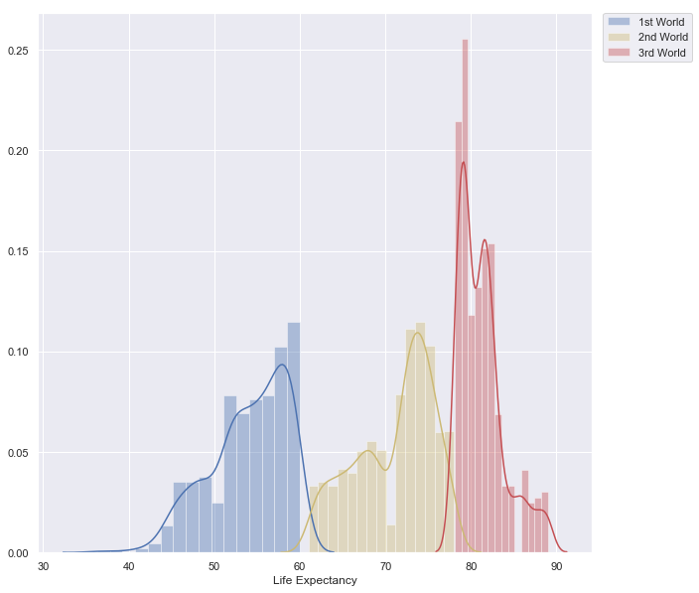
Status vs world feature
Status | count | mean | std | min | 25% | 50% | 75% | max
Developed | 512 | 79.2 | 3.9 | 69.9 | 76.8 | 79.25 | 81.7 | 89
Developing | 2426 | 67.1 | 9.0 | 36.3 | 61.1 | 69 | 74 | 89
world | count | mean | std | min | 25% | 50% | 75% | max
1 | 594 | 54.0 | 4.5 | 36.3 | 51.425 | 54.8 | 57.9 | 60
2 | 1877 | 71.0 | 4.6 | 61 | 67.5 | 72.5 | 74.6 | 78
3 | 467 | 81.2 | 2.6 | 78.1 | 79.1 | 81 | 82.3 | 89

Slide 13
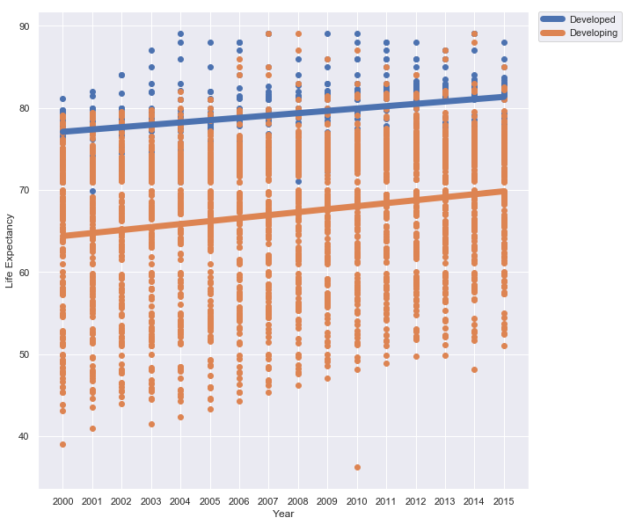
LIFE EXPECTANCY VERSus year

Slide 14
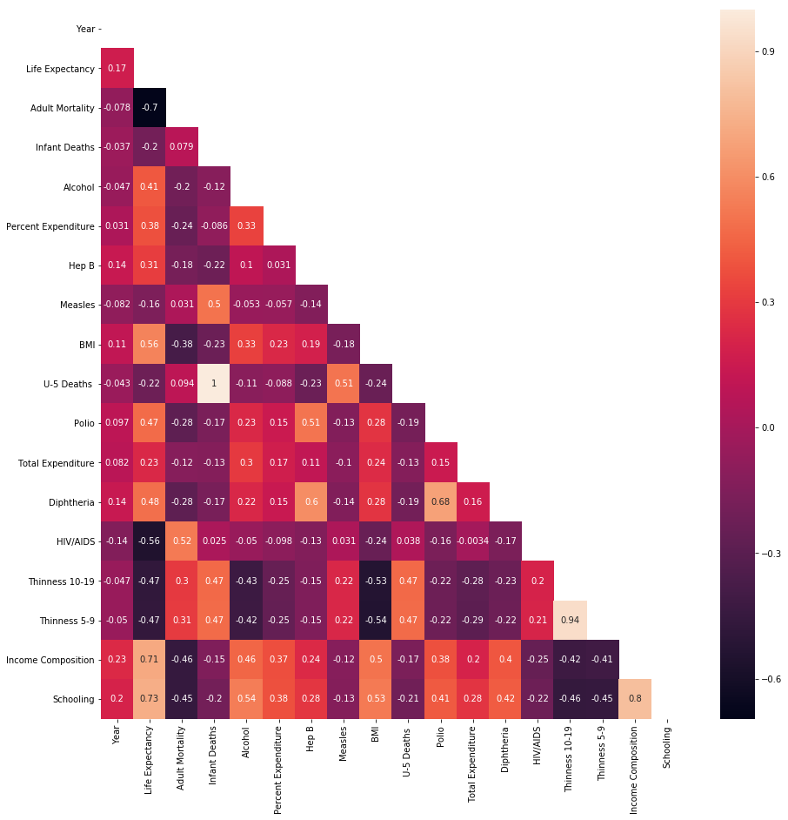
Life expectancy correlation and heat map
Schooling | 0.732084
Income Composition | 0.708651
BMI | 0.560105
Diphtheria | 0.483574
Polio | 0.470396
Alcohol | 0.407103
Percent Expenditure | 0.38199
Hep B | 0.314744
Total Expenditure | 0.226319
Year | 0.168709
Measles | -0.157401
Infant Deaths | -0.196324
U-5 Deaths | -0.222286
Thinness 5-9 | -0.468218
Thinness 10-19 | -0.473757
HIV/AIDS | -0.556165
Adult Mortality | -0.696386
Top 10 Positive and Negative Correlated Pairs
Pair |  | Value
Infant Deaths | U-5 Deaths | 0.996629
Thinness 10-19 | Thinness 5-9 | 0.939122
Income Composition | Schooling | 0.801269
Life Expectancy | Schooling | 0.732084
 | Income Composition | 0.708651
Polio | Diphtheria | 0.676641
Hep B | Diphtheria | 0.600456
Life Expectancy | BMI | 0.560105
Alcohol | Schooling | 0.541402
BMI | Schooling | 0.529271
Pair |  | Value
Adult Mortality | Schooling | -0.451296
Thinness 5-9 | Schooling | -0.452244
Adult Mortality | Income Composition | -0.455119
Thinness 10-19 | Schooling | -0.462581
Life Expectancy | Thinness 5-9 | -0.468218
 | Thinness 10-19 | -0.473757
BMI | Thinness 10-19 | -0.532155
 | Thinness 5-9 | -0.539039
Life Expectancy | HIV/AIDS | -0.556165
 | Adult Mortality | -0.696386

Slide 15
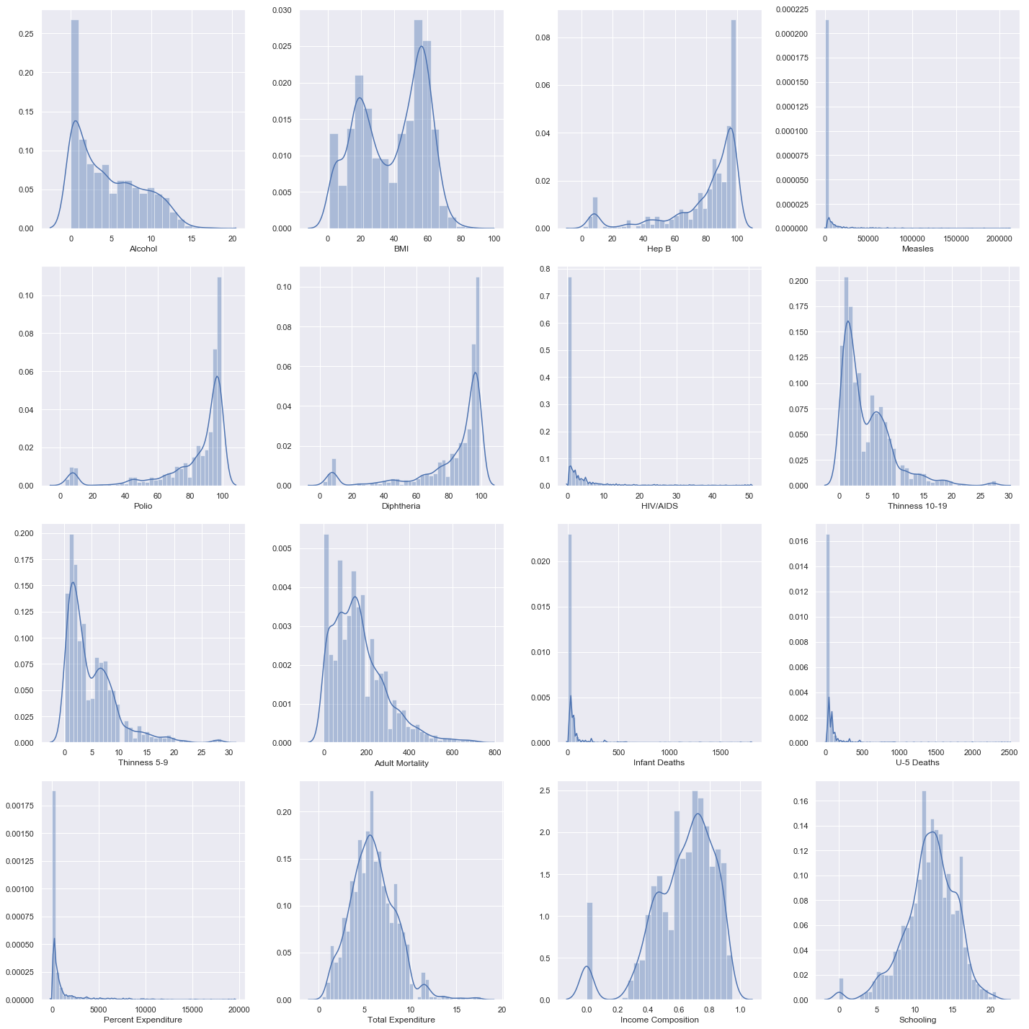
Feature Histograms
Notes:
Make histograms based on statu

Slide 16
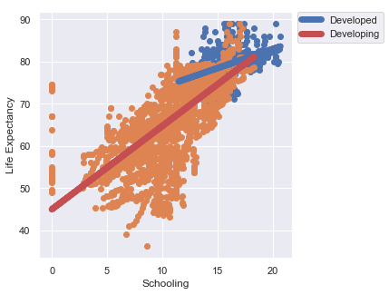
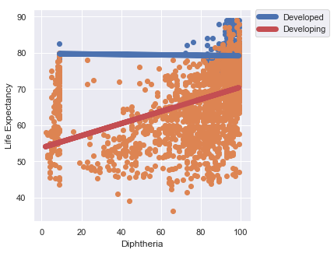
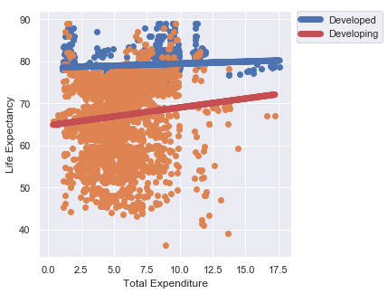
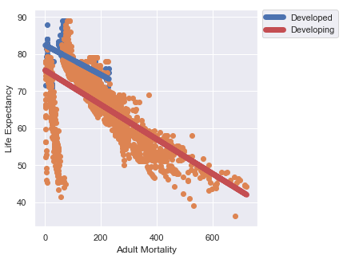
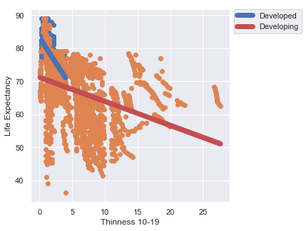
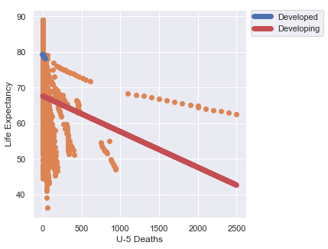
Life expectancy trends
+Correlation
-Correlation
Highest Tier Correlation (~.7)
Mid Tier Correlation(~.5)
Low Tier Correlation(~.2)

Slide 17
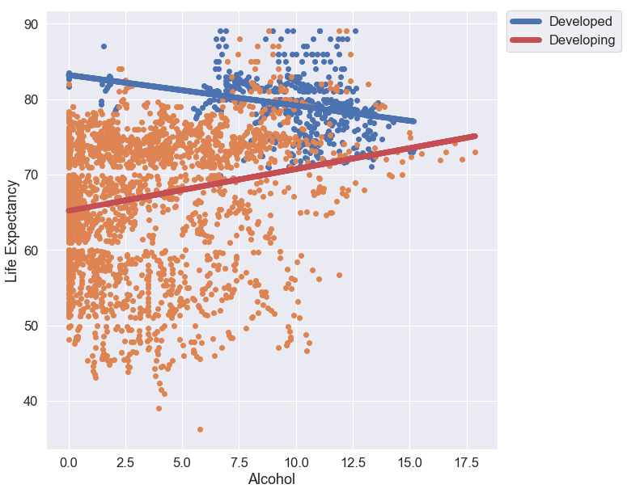
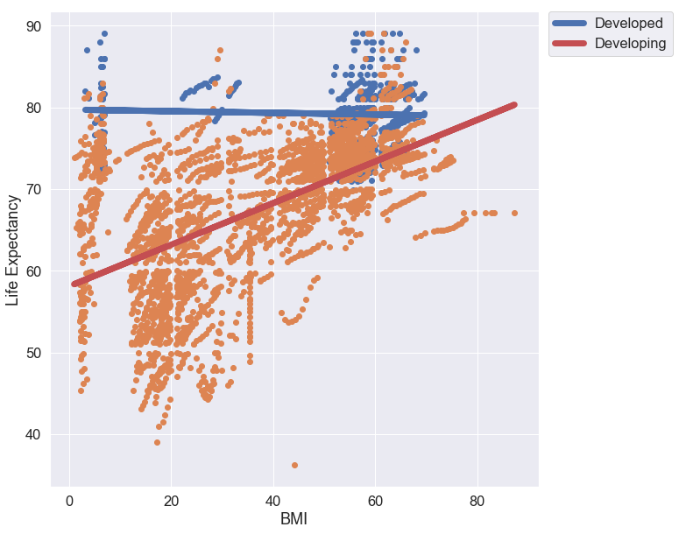
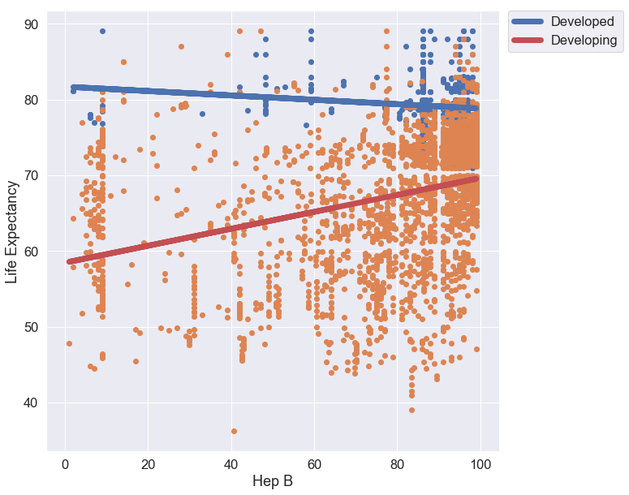
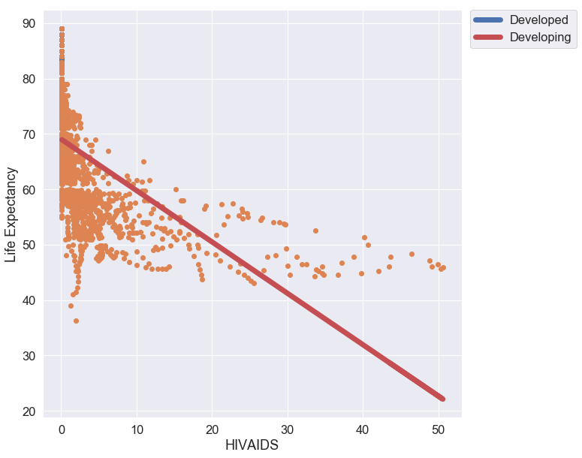
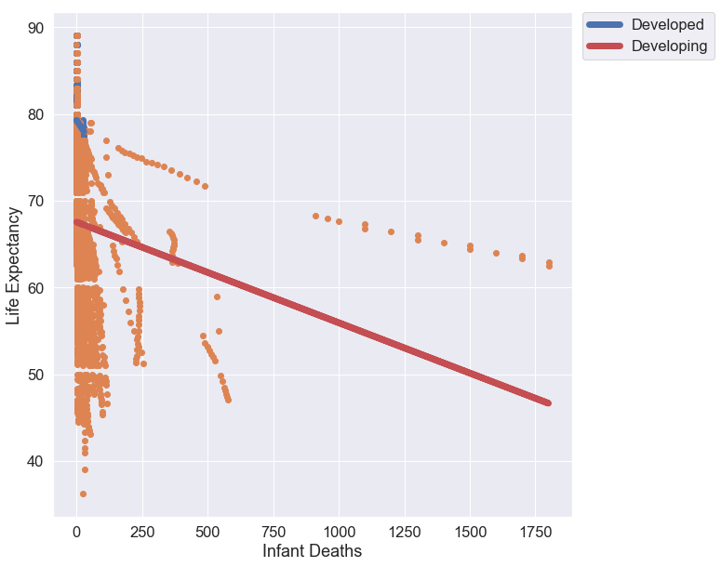
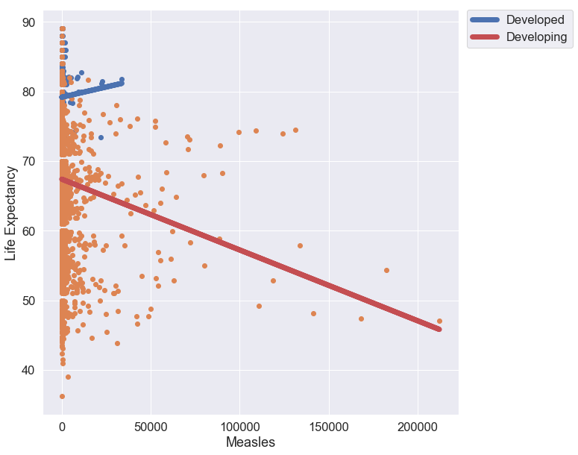
Life expectancy trends

Slide 18
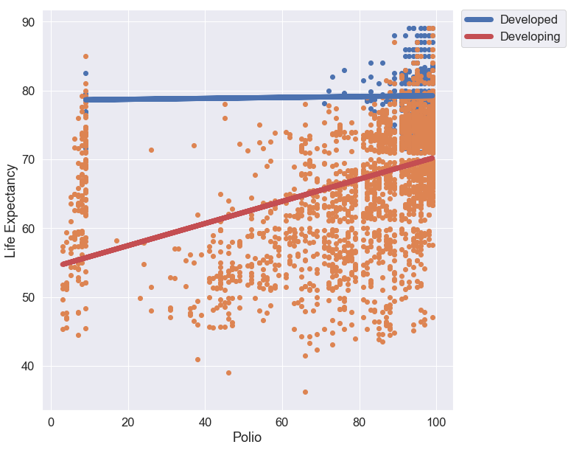
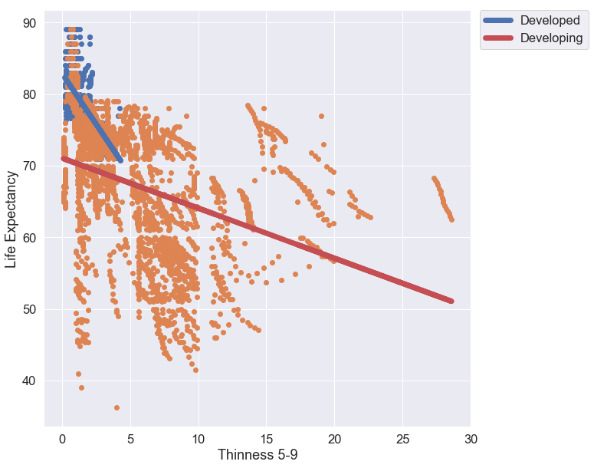
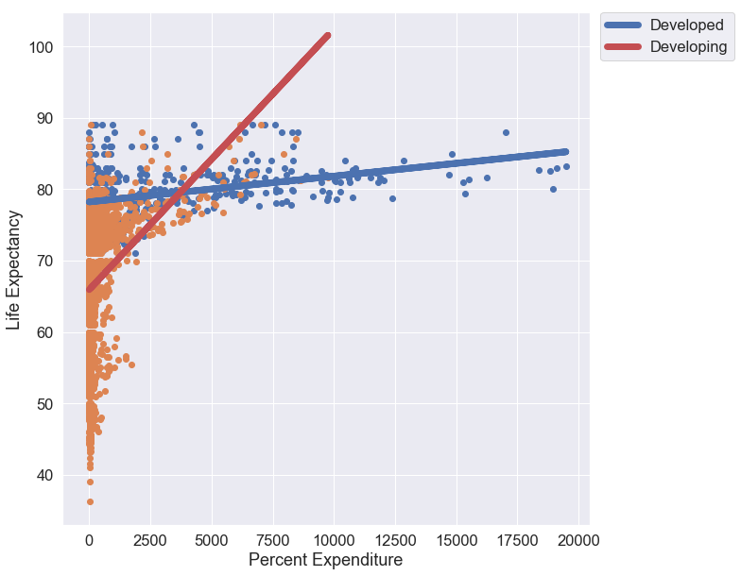
Life expectancy trends

Slide 19
Regression

Slide 20
Preparation and regression methods
781 Outliers were removed from data and the data was scaled due to varying feature values.
Thiel-sen (Robust Regression), Ridge , and Gradient Boosting Regression methods.
The data was split into 5 different statuses: Developed, Developing, 1st World, 2nd World, 3rd World, a training and test set with all statuses included, and a full data set.
Training data was from 2000- 2011, Testing after 2011 to 2015.
count | 2157
mean | 70.663418
std | 8.447265
min | 41
25% | 65.9
50% | 72.9
75% | 76
max | 89
Training
Testing
Notes:
Theil Sen-robust regression method by choosing the median of slope of all lines through pairs of points. It is able to ignore outliers present in the data.
Ridge-great with correlated features present in data.
Gradient Boosting- efficient and high powered gives feature importance
72% Training , 28 % Testings

Slide 21
Compiled mean results by method and status
Status | Method | Datapoint Count | RMSE | R² | LE Min | LE Max | Average LE | LE Std | LE Var
1st World | Gradient Boosting | 3024 | 0.4355 | 0.96835 | 78.15 | 88.6 | 81.45 | 2.278 | 5.188
 | Ridge | 3024 | 2.069 | 0.32315 | 76.55 | 85.2 | 81.45 | 1.331 | 1.7725
 | Thiel | 2688 | 5.2755 | -4.6652 | 27.35 | 86.15 | 81 | 4.956 | 35.4245
2nd World | Gradient Boosting | 12537 | 0.939 | 0.9543 | 61.5 | 77.65 | 71.4 | 4.271 | 18.3215
 | Ridge | 12537 | 2.352 | 0.7287 | 59.35 | 78.8 | 71.4 | 3.838 | 14.8085
 | Thiel | 11144 | 2.515 | 0.69085 | 55.75 | 79.35 | 71.45 | 4.215 | 17.9445
3rd World | Gradient Boosting | 2556 | 0.2615 | 0.99425 | 44.75 | 59.95 | 55.4 | 3.4695 | 12.4105
 | Ridge | 2556 | 2.644 | 0.4552 | 49.45 | 59.95 | 55.4 | 2.159 | 4.8855
 | Thiel | 2272 | 2.7825 | 0.39155 | 48.8 | 61.2 | 55.95 | 2.54 | 6.561
Developed | Gradient Boosting | 3447 | 0.4155 | 0.98635 | 71.95 | 88.35 | 79.25 | 3.781 | 14.304
 | Ridge | 3447 | 2.181 | 0.69095 | 71.6 | 84.45 | 79.25 | 3.159 | 9.985
 | Thiel | 3064 | 2.3095 | 0.65295 | 71.55 | 86.25 | 79.25 | 3.2115 | 10.303
Developing | Gradient Boosting | 14670 | 1.1905 | 0.9772 | 45.7 | 85.65 | 69.05 | 7.655 | 58.739
 | Ridge | 14670 | 3.107 | 0.84375 | 46.35 | 83 | 69.05 | 7.186 | 51.8135
 | Thiel | 13040 | 3.232 | 0.83095 | 44.7 | 83.9 | 69.25 | 7.432 | 55.3355
Full | Gradient Boosting | 38826 | 1.688 | 0.9601 | 42 | 85 | 70.7 | 8.147 | 66.366
 | Ridge | 38826 | 3.062 | 0.8685 | 42.3 | 83.5 | 70.7 | 7.846 | 61.553
 | Thiel | 34512 | 3.191 | 0.8572 | 41.5 | 84.5 | 70.9 | 7.791 | 60.694
Full Testing | Gradient Boosting | 10908 | 1.207 | 0.9775 | 48.8 | 86.2 | 71.7 | 7.819 | 61.143
 | Ridge | 10908 | 3.068 | 0.8549 | 49.4 | 84.5 | 71.7 | 7.391 | 54.621
 | Thiel | 9696 | 3.272 | 0.835 | 47.3 | 87.5 | 71.9 | 7.798 | 60.806
Full Training | Gradient Boosting | 25326 | 1.533 | 0.9679 | 42.9 | 86.1 | 70.2 | 8.287 | 68.668
 | Ridge | 25326 | 3.049 | 0.8731 | 42.7 | 83.4 | 70.2 | 7.963 | 63.404
 | Thiel | 22512 | 3.18 | 0.862 | 41.5 | 83.6 | 70.3 | 7.915 | 62.651

Slide 22
Thiel and Ridge results
Iteration | Method | Set | Status | Datapoint Count | RMSE | R² | LE Min | LE Max | Average LE | LE Std | LE Var
1 | Thiel | X_developed_train | Developed | 4448 | 2.18 | 0.69 | 69.8 | 84.1 | 77.9 | 3.26 | 10.6
2 | Thiel | X_developed_test | Developed | 1680 | 2.439 | 0.6159 | 73.3 | 88.4 | 80.6 | 3.163 | 10.006
3 | Thiel | X_developing_train | Developing | 18064 | 3.272 | 0.8434 | 41.3 | 82.7 | 68.5 | 7.744 | 59.969
4 | Thiel | X_developing_test | Developing | 8016 | 3.192 | 0.8185 | 48.1 | 85.1 | 70 | 7.12 | 50.702
5 | Thiel | X_world1_train | 1st World | 3616 | 8.286 | -9.4894 | -20.1 | 84.3 | 79.5 | 8.252 | 68.092
6 | Thiel | X_world1_test | 1st World | 1760 | 2.265 | 0.159 | 74.8 | 88 | 82.5 | 1.66 | 2.757
7 | Thiel | X_world2_train | 2nd World | 15456 | 2.549 | 0.6533 | 59.7 | 80.2 | 71.3 | 3.794 | 14.394
8 | Thiel | X_world2_test | 2nd World | 6832 | 2.481 | 0.7284 | 51.8 | 78.5 | 71.6 | 4.636 | 21.495
9 | Thiel | X_world3_train | 3rd World | 3440 | 3.32 | 0.386 | 45.3 | 61.5 | 54.9 | 2.872 | 8.249
10 | Thiel | X_world3_test | 3rd World | 1104 | 2.245 | 0.3971 | 52.3 | 60.9 | 57 | 2.208 | 4.873
11 | Thiel | X_train | Full Training | 22512 | 3.18 | 0.862 | 41.5 | 83.6 | 70.3 | 7.915 | 62.651
12 | Thiel | X_test | Full Testing | 9696 | 3.272 | 0.835 | 47.3 | 87.5 | 71.9 | 7.798 | 60.806
13 | Thiel | X | Full | 34512 | 3.191 | 0.8572 | 41.5 | 84.5 | 70.9 | 7.791 | 60.694
Iteration | Method | Set | Status | Datapoint Count | RMSE | R² | LE Min | LE Max | Average LE | LE Std | LE Var
1 | Ridge | X_developed_train | Developed | 5004 | 2.127 | 0.7044 | 70.2 | 83.9 | 78.1 | 3.227 | 10.416
2 | Ridge | X_developed_test | Developed | 1890 | 2.235 | 0.6775 | 73 | 85 | 80.4 | 3.091 | 9.554
3 | Ridge | X_developing_train | Developing | 20322 | 3.137 | 0.8561 | 42.8 | 80.9 | 68.2 | 7.606 | 57.849
4 | Ridge | X_developing_test | Developing | 9018 | 3.077 | 0.8314 | 49.9 | 85.1 | 69.9 | 6.766 | 45.778
5 | Ridge | X_world1_train | 1st World | 4068 | 2.155 | 0.2909 | 77 | 84.5 | 80.6 | 1.302 | 1.696
6 | Ridge | X_world1_test | 1st World | 1980 | 1.983 | 0.3554 | 76.1 | 85.9 | 82.3 | 1.36 | 1.849
7 | Ridge | X_world2_train | 2nd World | 17388 | 2.422 | 0.6872 | 60.2 | 79.4 | 71.3 | 3.554 | 12.628
8 | Ridge | X_world2_test | 2nd World | 7686 | 2.282 | 0.7702 | 58.5 | 78.2 | 71.5 | 4.122 | 16.989
9 | Ridge | X_world3_train | 3rd World | 3870 | 3.219 | 0.4225 | 46.3 | 60 | 54.3 | 2.632 | 6.929
10 | Ridge | X_world3_test | 3rd World | 1242 | 2.069 | 0.4879 | 52.6 | 59.9 | 56.5 | 1.686 | 2.842
11 | Ridge | X_train | Full Training | 25326 | 3.049 | 0.8731 | 42.7 | 83.4 | 70.2 | 7.963 | 63.404
12 | Ridge | X_test | Full Testing | 10908 | 3.068 | 0.8549 | 49.4 | 84.5 | 71.7 | 7.391 | 54.621
13 | Ridge | X | Full | 38826 | 3.062 | 0.8685 | 42.3 | 83.5 | 70.7 | 7.846 | 61.553

Slide 23
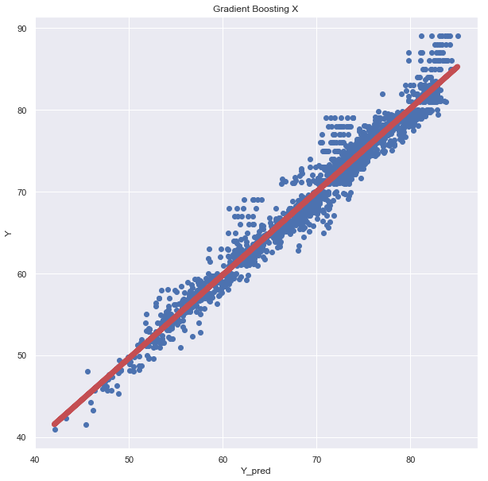
Gradient boosting results
Iteration | Method | Set | Status | Datapoint Count | RMSE | R² | LE Min | LE Max | Average LE | LE Std | LE Var
1 | Gradient Boosting | X_developed_train | Developed | 5004 | 0.608 | 0.9759 | 70.8 | 88.1 | 78.1 | 3.703 | 13.713
2 | Gradient Boosting | X_developed_test | Developed | 1890 | 0.223 | 0.9968 | 73.1 | 88.6 | 80.4 | 3.859 | 14.895
3 | Gradient Boosting | X_developing_train | Developing | 20322 | 1.354 | 0.9732 | 42.4 | 85.1 | 68.2 | 8.028 | 64.453
4 | Gradient Boosting | X_developing_test | Developing | 9018 | 1.027 | 0.9812 | 49 | 86.2 | 69.9 | 7.282 | 53.025
5 | Gradient Boosting | X_world1_train | 1st World | 4068 | 0.553 | 0.9533 | 78.1 | 88.5 | 80.6 | 2.255 | 5.083
6 | Gradient Boosting | X_world1_test | 1st World | 1980 | 0.318 | 0.9834 | 78.2 | 88.7 | 82.3 | 2.301 | 5.293
7 | Gradient Boosting | X_world2_train | 2nd World | 17388 | 1.102 | 0.9352 | 61.1 | 77.5 | 71.3 | 3.989 | 15.91
8 | Gradient Boosting | X_world2_test | 2nd World | 7686 | 0.776 | 0.9734 | 61.9 | 77.8 | 71.5 | 4.553 | 20.733
9 | Gradient Boosting | X_world3_train | 3rd World | 3870 | 0.435 | 0.9894 | 41.3 | 59.9 | 54.3 | 4.082 | 16.659
10 | Gradient Boosting | X_world3_test | 3rd World | 1242 | 0.088 | 0.9991 | 48.2 | 60 | 56.5 | 2.857 | 8.162
11 | Gradient Boosting | X_train | Full Training | 25326 | 1.533 | 0.9679 | 42.9 | 86.1 | 70.2 | 8.287 | 68.668
12 | Gradient Boosting | X_test | Full Testing | 10908 | 1.207 | 0.9775 | 48.8 | 86.2 | 71.7 | 7.819 | 61.143
13 | Gradient Boosting | X | Full | 38826 | 1.688 | 0.9601 | 42 | 85 | 70.7 | 8.147 | 66.366

Slide 24
Gradient boosting feature importance
Developed | Developing | 1st World | 2nd World | 3rd world | Xtrain | X | AVG
Adult Mortality | HIVAIDS | Adult Mortality | Adult Mortality | AdultMortality | Income Composition | Income Composition | Income Composition
Income Composition | Income Composition | Income Composition | Income Composition | HIVAIDS | HIVAIDS | HIVAIDS | Adult Mortality
Thinness 5-9 | Adult Mortality | Thinness 10-19 | Schooling | country_code | Adult Mortality | AdultMortality | HIVAIDS
TotalExpenditure | Schooling | Year | HIVAIDS | Income Composition | Schooling | Thinness 5-9 | Schooling
Alcohol | Polio | Schooling | Thinness 5-9 | U-5 Deaths | Thinness 5-9 | U5 Deaths | Thinness 5-9
Feature | X_developed_train | X_developed_test | X_developing_train | X_developing_test | X_world1_train | X_world1_test | X_world2_train | X_world2_test | X_world3_train | X_world3_test | X_train | X_test | X | Avg
Year | 1.4 | 0.33 | 0.07 | 0.06 | 13.59 | 2.16 | 0.14 | 0.1 | 1.11 | 0.71 | 0.05 | 0.02 | 0.16 | 1.53
AdultMortality | 24.78 | 78.97 | 17.23 | 11.3 | 25.71 | 25.31 | 53.39 | 23.99 | 31.57 | 34.34 | 12.68 | 9.01 | 11.47 | 27.67
Infant Deaths | 0.1 | 0.01 | 0.87 | 0.4 | 0.54 | 0.16 | 0.16 | 0.24 | 3.6 | 3.54 | 0.26 | 0.13 | 0.14 | 0.78
Alcohol | 4.81 | 2.3 | 0.95 | 1.69 | 3.76 | 7.48 | 2.49 | 0.74 | 2.09 | 0.63 | 0.75 | 1.01 | 0.75 | 2.27
PercentExpenditure | 1.49 | 0.21 | 0.15 | 0.17 | 4.41 | 3.57 | 1.34 | 0.4 | 0.72 | 1.62 | 0.24 | 0.04 | 0.1 | 1.11
Hep B | 1.02 | 0.13 | 0.07 | 0.21 | 2.7 | 0.37 | 0.19 | 0.18 | 1.51 | 1.42 | 0.03 | 0.15 | 0.02 | 0.62
Measles | 0.6 | 0.79 | 0.1 | 0.32 | 4.33 | 5.2 | 0.39 | 0.18 | 0.42 | 6.71 | 0.12 | 0.21 | 0.18 | 1.50
BMI | 1.46 | 2.58 | 2.86 | 0.46 | 4.99 | 5.98 | 3.67 | 0.32 | 6.25 | 1.89 | 1.24 | 0.7 | 0.7 | 2.55
U5Deaths | 0.13 | 0.04 | 1.44 | 1.21 | 0.88 | 0.65 | 0.46 | 0.32 | 4.48 | 6.19 | 1.53 | 0.64 | 1.85 | 1.52
Polio | 0.25 | 0.12 | 3.9 | 1.12 | 3.01 | 0.14 | 1.17 | 1.45 | 2.71 | 0.11 | 2.34 | 0.61 | 1.45 | 1.41
TotalExpenditure | 4.05 | 4.78 | 0.37 | 1.86 | 3.4 | 5.65 | 0.59 | 1.57 | 1.13 | 9 | 0.19 | 1.23 | 0.28 | 2.62
Diphtheria | 0.41 | 0.24 | 0.65 | 0.7 | 2.36 | 0.22 | 0.57 | 0.03 | 6.34 | 0.02 | 0.83 | 0.62 | 0.83 | 1.06
HIVAIDS | 0 | 0 | 23.82 | 46.36 | 0 | 0 | 1.94 | 4 | 7.78 | 18.48 | 18.01 | 31.99 | 18.17 | 13.12
Thinness 10-19 | 3.52 | 0.9 | 0.11 | 1.04 | 3.68 | 15.25 | 0.66 | 1.39 | 0.34 | 3.38 | 0.22 | 1.14 | 0.27 | 2.45
Thinness 5-9 | 14.83 | 0.25 | 1.52 | 1.75 | 0.12 | 12.19 | 2.31 | 3.27 | 0.87 | 5.26 | 2.44 | 2.63 | 2.34 | 3.83
IncomeComposition | 37.64 | 7.28 | 44.42 | 23.2 | 16.3 | 5.47 | 28.95 | 44.33 | 14.92 | 1.81 | 58 | 35.65 | 60.59 | 29.12
Schooling | 2.28 | 0.77 | 0.41 | 7.21 | 3.81 | 8.66 | 0.87 | 16.25 | 1.25 | 0.2 | 0.25 | 13.73 | 0.16 | 4.30
country_code | 1.23 | 0.31 | 1.06 | 0.94 | 6.42 | 1.56 | 0.71 | 1.22 | 12.91 | 4.69 | 0.8 | 0.49 | 0.53 | 2.53
Income Composition , Adult Mortality, HIV/AIDS, Schooling and Thinness 5-9 most important in LE gradient boosting across all models.

Slide 25
clustering

Slide 26
clustering methods and evaluation
Mean-Shift and K-Means Clustering with scaling of the full data set.
K-Means cluster chosen by comparing scores calculated below.
Silhouette and Calinski-Harabaz scores were used as non-ground truth scores.
Completeness, Homogeneity, and ARI scores were used as ground truth scores related to the world feature.
Percentages of each cluster were calculated to choose the appropriate clustering methods.
Notes:
Calinski-Harabaz Index- additionally known as the Variance Ratio Criterion where a higher score means a better defined cluster. It compares the ratio of the between-clusters dispersion mean and the within-cluster dispersion. Scores are higher when dense and separated from other clusters. The score is normalized with respect to the others scores for comparison in one chart
Silhouette Score- is the ratio of difference between the mean nearest-cluster distance and mean intra-cluster distance over the maximum between both scores. The score ranges from -1 to +1. +1 indicates a highly dense cluster while scores close to 0 indicates overlapping clusters and -1 indicates incorrect clustering.

Slide 27
clustering evaluation scores
Calinski-Harabaz Index-
Additionally known as the Variance Ratio Criterion where a higher score means a better defined cluster.
It compares the ratio of the between-clusters dispersion mean and the within-cluster dispersion.
Scores are higher when dense and separated from other clusters.
The score is normalized with respect to the others scores for comparison in one chart.
Silhouette Score-
the ratio of difference between the mean nearest-cluster distance and mean intra-cluster distance over the maximum between both scores.
+1 indicates a highly dense cluster while scores close to 0 indicates overlapping clusters and -1 indicates incorrect clustering. s=(b-a)/max(b,a) mean intra-cluster distance (a) mean nearest-cluster distance (b)
Source: Caliński, T., & Harabasz, J. (1974). “A dendrite method for cluster analysis”. Communications in Statistics-theory and Methods 3: 1-27. doi:10.1080/03610926.2011.560741.
Source: Peter J. Rousseeuw (1987). “Silhouettes: a Graphical Aid to the Interpretation and Validation of Cluster Analysis”. Computational and Applied Mathematics 20: 53–65. doi:10.1016/0377-0427(87)90125-7.
Notes:
Calinski-Harabaz Index- additionally known as the Variance Ratio Criterion where a higher score means a better defined cluster. It compares the ratio of the between-clusters dispersion mean and the within-cluster dispersion. Scores are higher when dense and separated from other clusters. The score is normalized with respect to the others scores for comparison in one chart
Silhouette Score- is the ratio of difference between the mean nearest-cluster distance and mean intra-cluster distance over the maximum between both scores. The score ranges from -1 to +1. +1 indicates a highly dense cluster while scores close to 0 indicates overlapping clusters and -1 indicates incorrect clustering.

Slide 28
clustering evaluation scores
Homogeneity Score- Each cluster contains only members of a single class.
Completeness Score-All members of a given class are assigned to the same cluster.
Adjusted Rand Score-The Rand Index compares how pairs of datapoints relate in the ground truth and in the post-clustering assignment. There are four possible types of pair relationships: a=Members of the same cluster in the ground truth match same cluster in the new solution. b=Members of the same cluster in the ground truth match different clusters in the new solution. c=Members of different clusters in the ground truth match the same cluster in the new solution. d=Members of different clusters in the ground truth match different clusters in the new solution. E(RI)- expected RI RI=(a+c)/sum(a,b,c,d) ARI=(RI-E(RI)/(max(RI)-E(RI))
Notes:
Calinski-Harabaz Index- additionally known as the Variance Ratio Criterion where a higher score means a better defined cluster. It compares the ratio of the between-clusters dispersion mean and the within-cluster dispersion. Scores are higher when dense and separated from other clusters. The score is normalized with respect to the others scores for comparison in one chart
Silhouette Score- is the ratio of difference between the mean nearest-cluster distance and mean intra-cluster distance over the maximum between both scores. The score ranges from -1 to +1. +1 indicates a highly dense cluster while scores close to 0 indicates overlapping clusters and -1 indicates incorrect clustering.

Slide 29
Comparison of K-means and mean shift
Mean-Shift
Number of Estimated Clusters: | 3
Calinski Harabaz Score | 0.09
Silhouette Score | 0.35
Homogenity Score | 0.15
Completeness Score | 0.02
K-Means
Number of Clusters | 3
Calinski Harabaz Score | 0.640
Silhouette Score | 0.215
Homogenity Score | 0.362
Completeness Score | 0.460
Mean Shift Cluster Percentages
0 | 97.5
1 | 1.9
2 | 0.6
K-Means Cluster Percentages
0 | 47.5
1 | 29.3
2 | 23.3

Slide 30
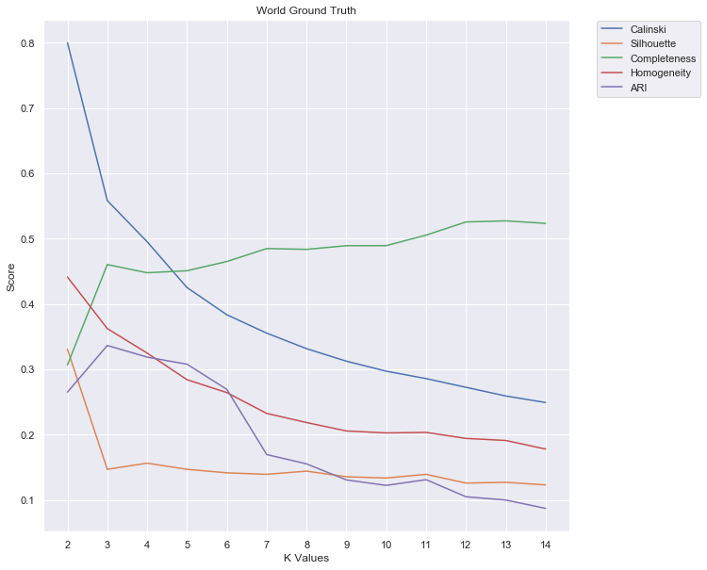
K-cluster determination

Slide 31
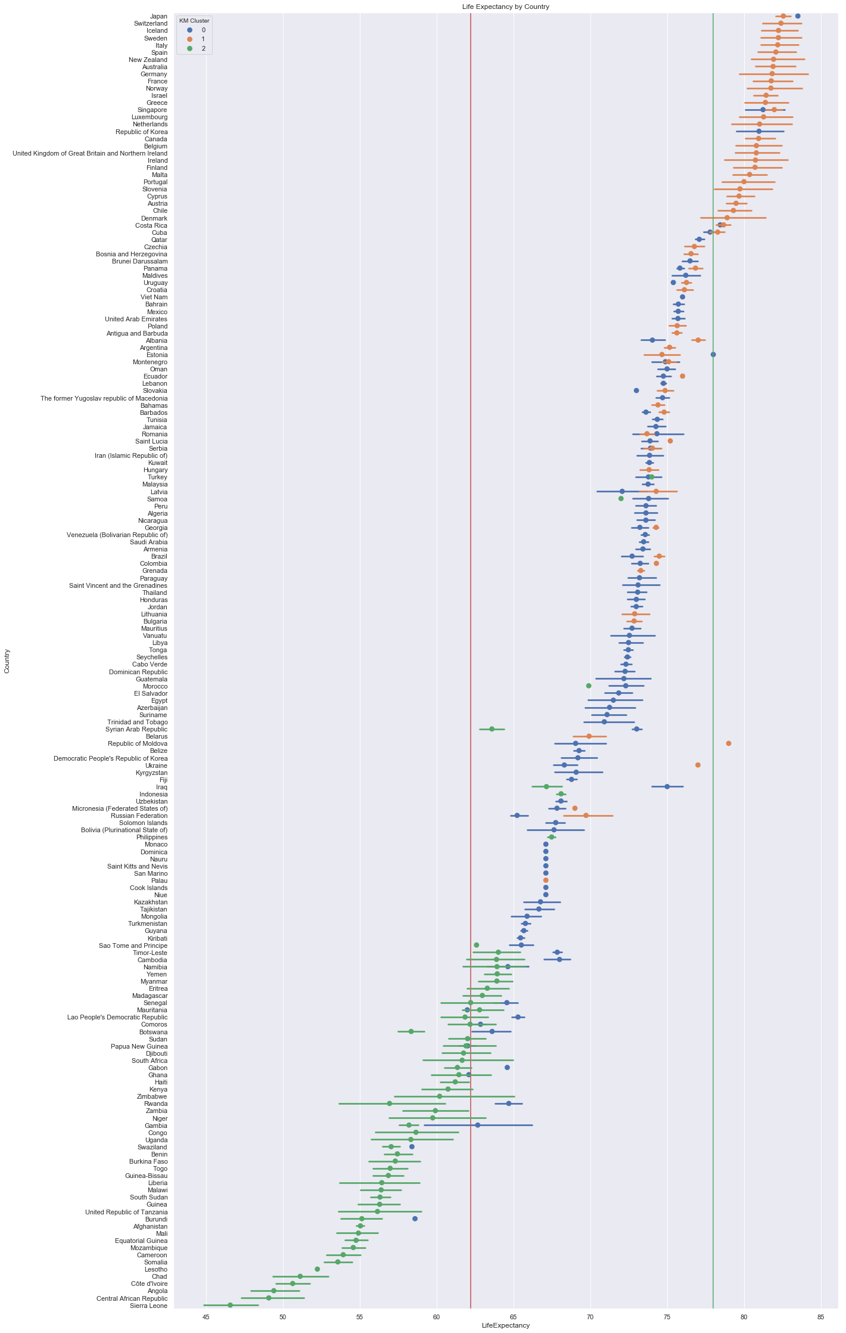
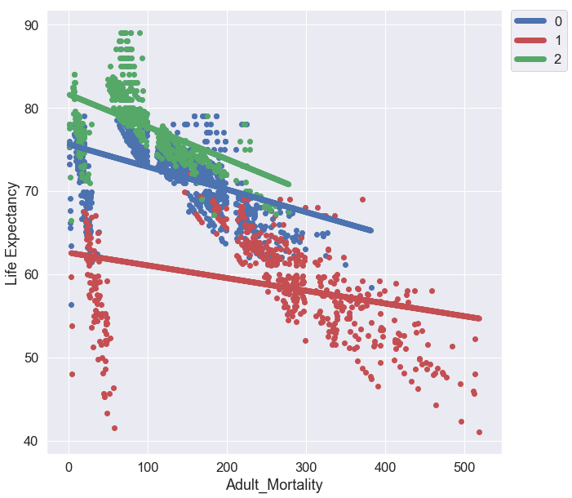
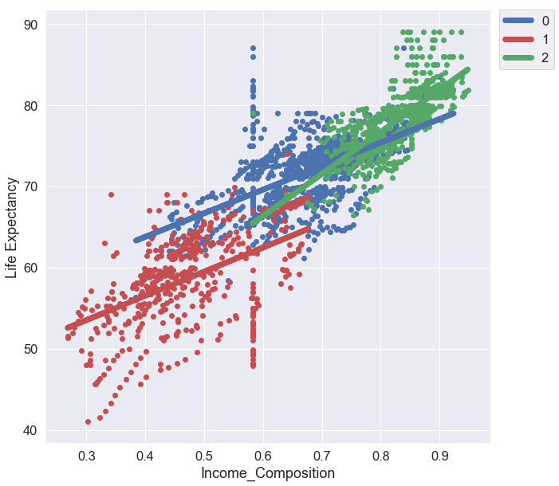
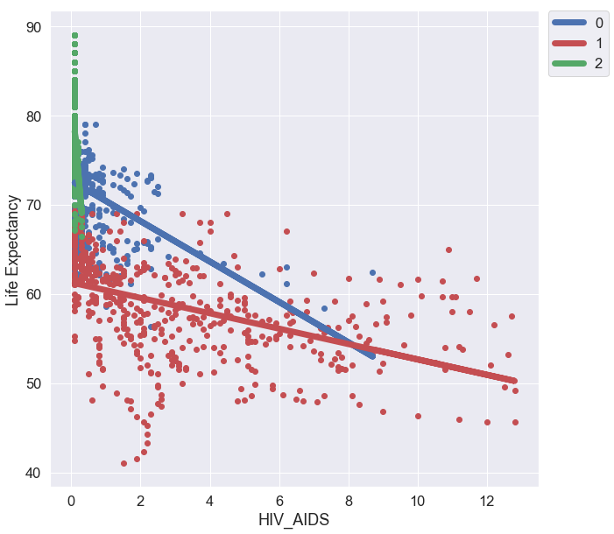
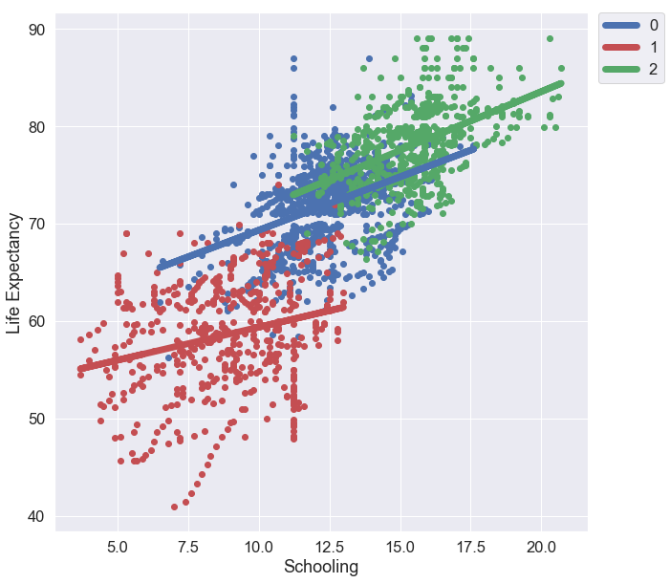
Applied k-means clustering

Slide 32
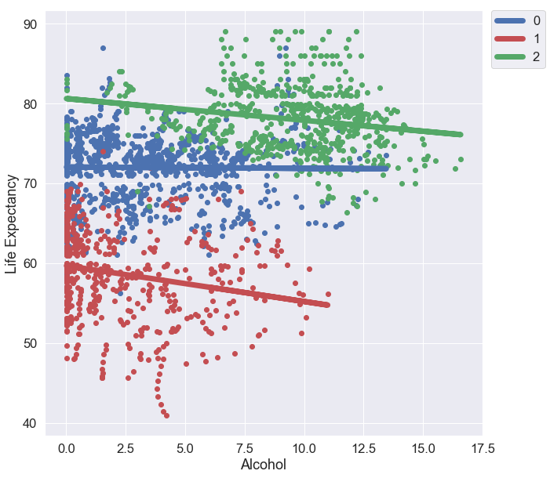
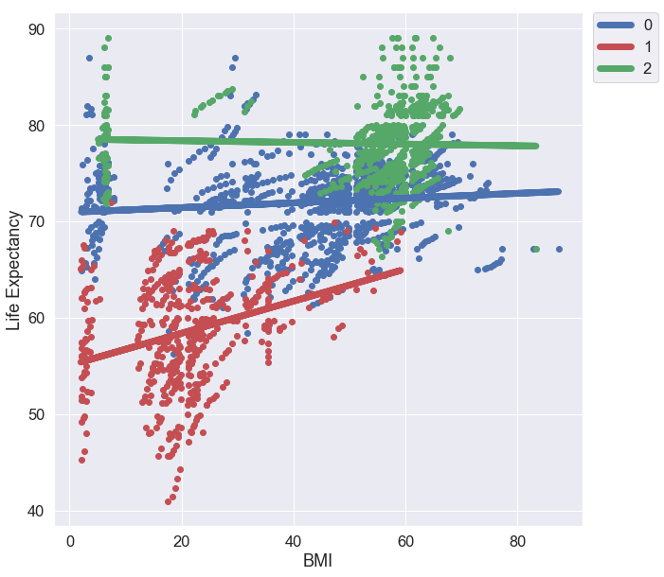
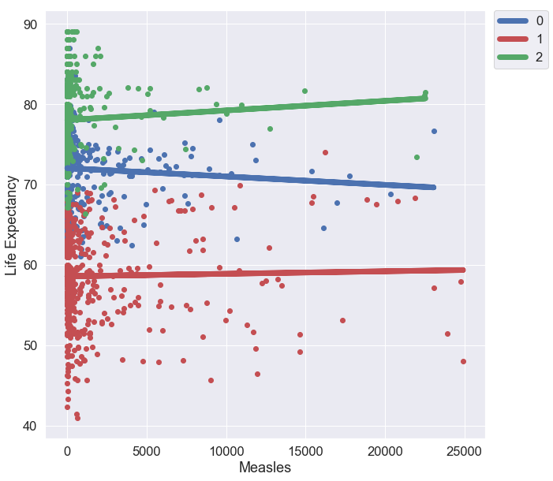
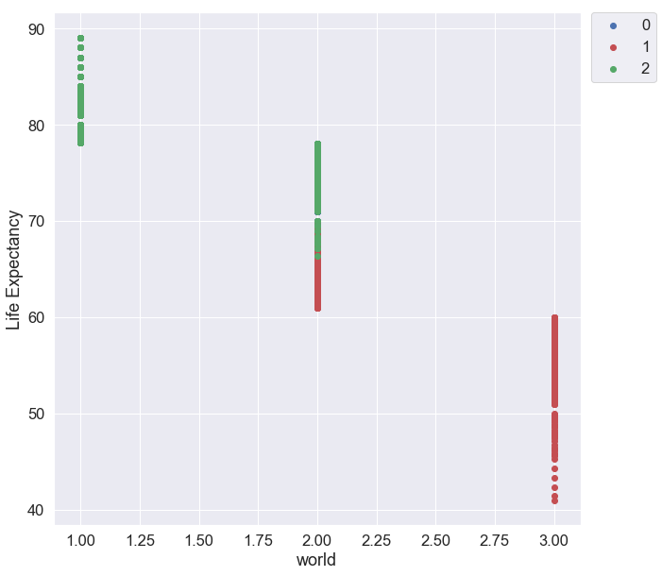
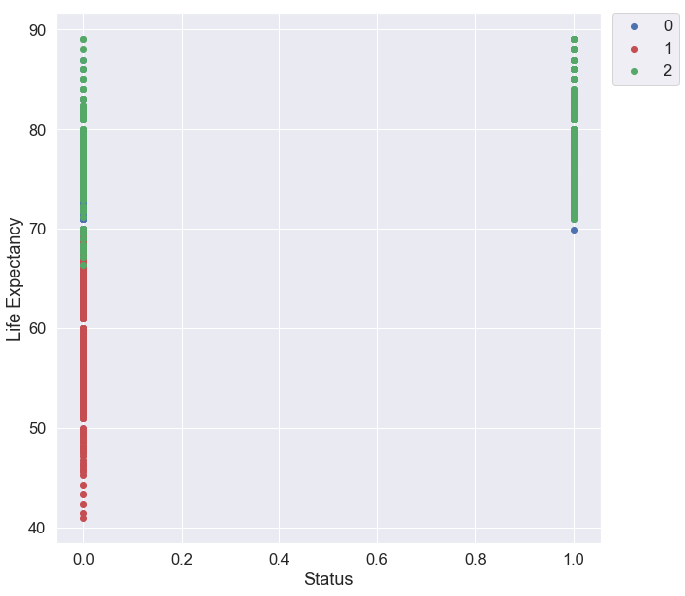
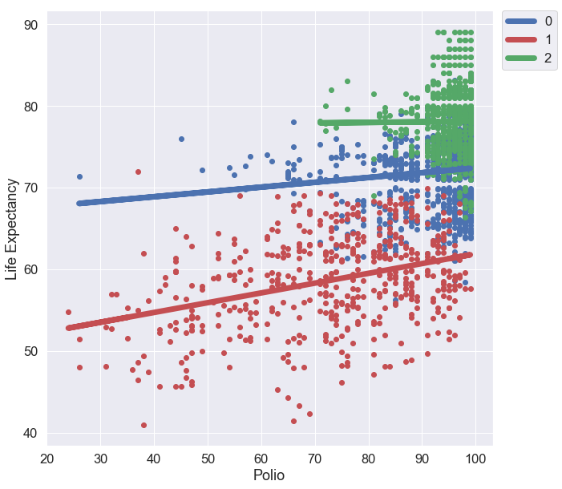
Applied k-means clustering

Slide 33
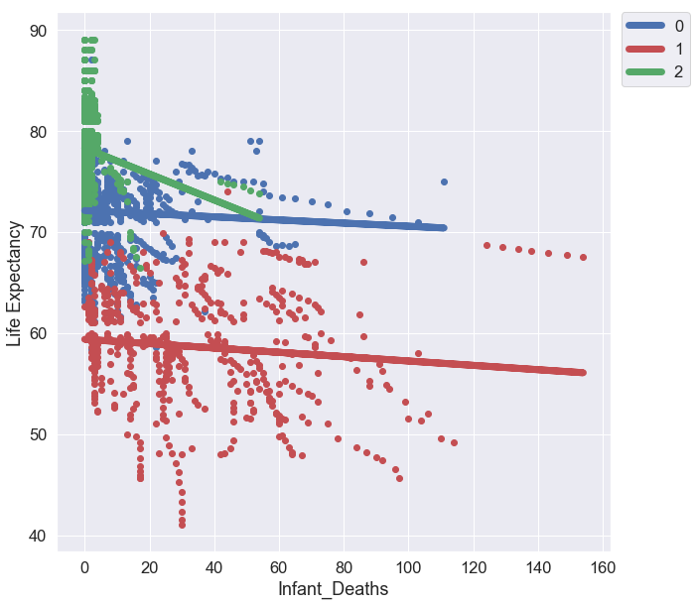
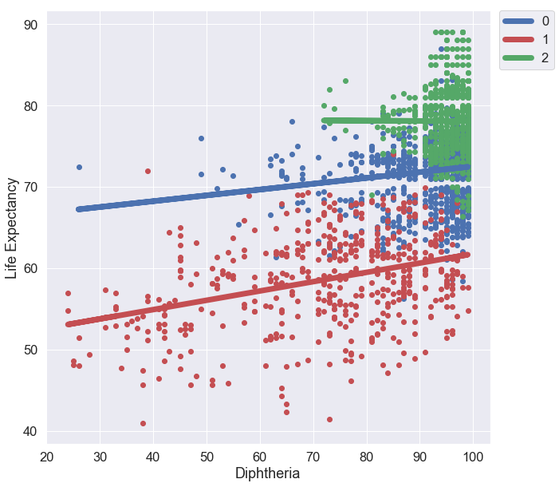
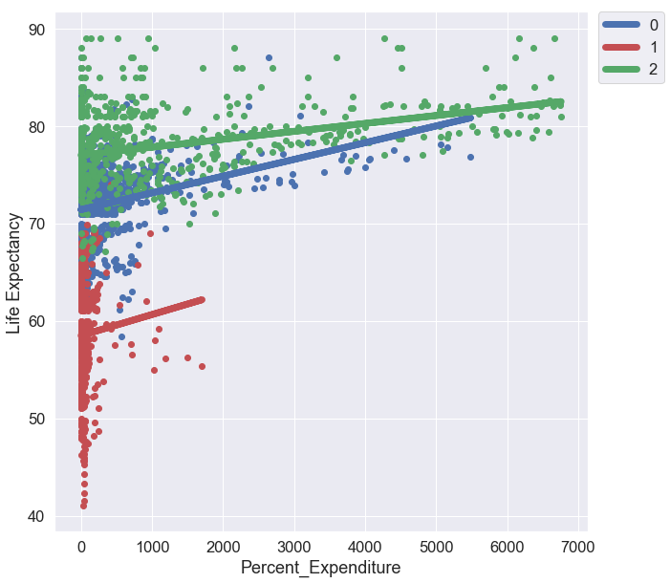
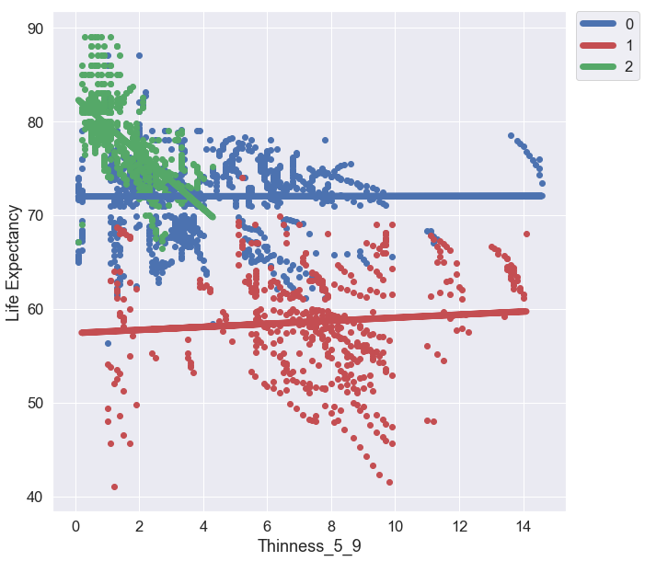
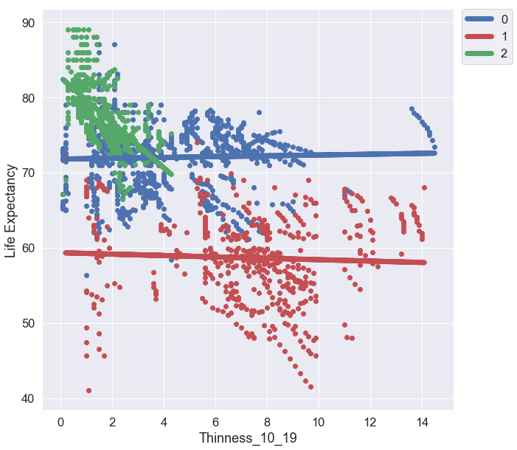
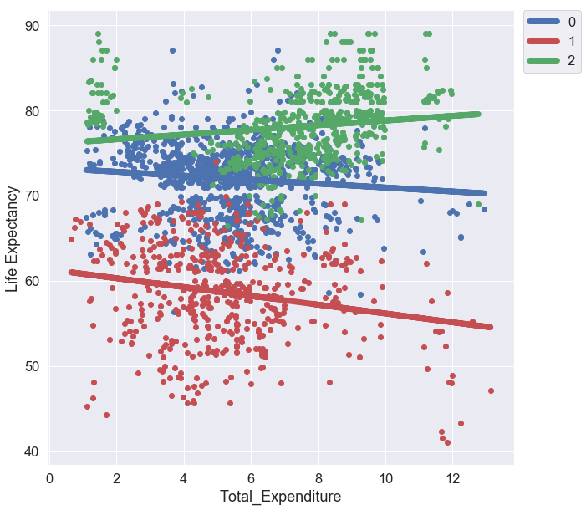
Applied k-means clustering

Slide 34
Mixed effect models

Slide 35
Mixed effect model Assumptions
Mixed Effect Models have the following assumptions:
The features are related linearly to the outcome.
The errors have constant variance: In other words, the model fits equally well for all values of the outcome and features within a level.
The errors are independent: The fit of the model within a group(level 1) is uncorrelated with the fit of the model at between a group (level 2).
The errors are normally distributed.
Observations within a person/group are correlated with one another(high ICC).

Slide 36
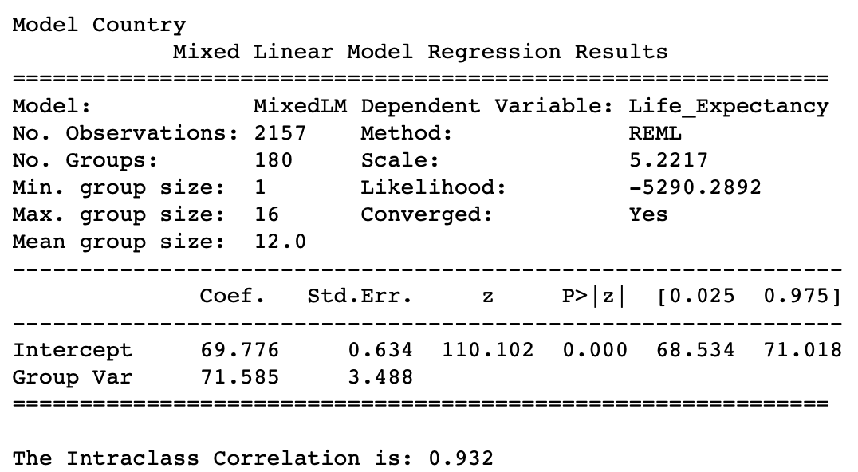
ICC and group feature selection
Column | ICC | Group Var
Year | 0.004 | 0.308
Country | 0.932 | 71.58
Status | 0.469 | 49.63
Adult_Mortality | 0.905 | 94.02
Infant_Deaths | 0.408 | 27.72
Alcohol | 0.24 | 17.12
Percent_Expenditure | 0.008 | 0.58
Hep_B | 0.582 | 58.37
Measles | 0.46 | 42.51
BMI | 0.611 | 43.48
U_5_Deaths | 0.431 | 28.92
Polio | 0.503 | 43.37
Total_Expenditure | 0.162 | 11.6
Diphtheria | 0.528 | 47.27
HIV_AIDS | 0.43 | 20.75
Thinness_10_19 | 0.504 | 37.14
Thinness_5_9 | 0.504 | 36.81
Income_Composition | 0.82 | 78
Schooling | 0.78 | 90.07
world | 0.908 | 172.93
Sample Calculation
ICC=71.585/71.585+5.22=.932
group var: between-group variance resid: within-group variance ICC= group var/(group var +resid)
Notes:
A low ICC score means that observations within groupings are not similiar than observations between the groupings themselves
A higher ICC indicates that there is a high similarity between observations within a group and a mixed effect model is appropriate.

Slide 37
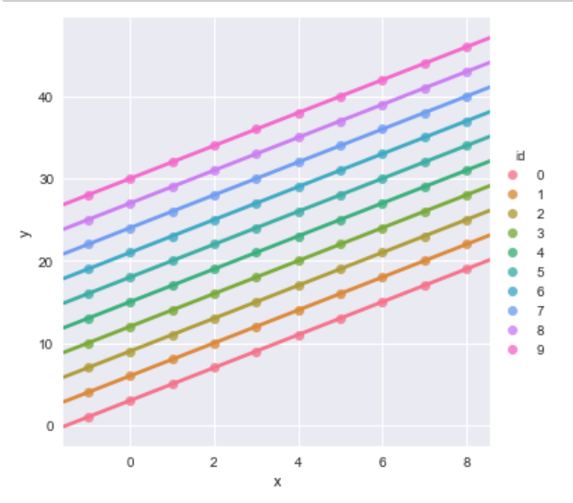
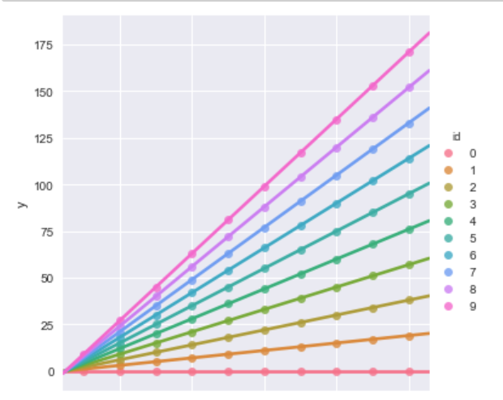
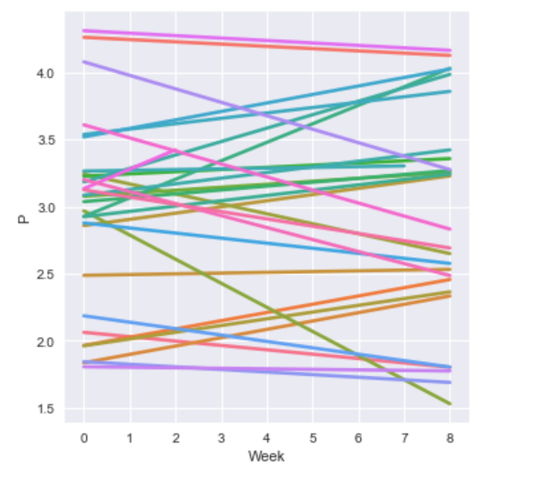
Mixed effect models
Random Intercepts
RE=Null
Random Slopes
RE=~0+Feature Name
Random Slopes and Intercepts
RE=~Feature Name
Notes:
Random Intercepts-individuals within a group are allowed to have different intercepts while all keeping the same slope. (No RE Added)
Random Slopes-individuals within a group are allowed to have different slopes while all keeping the same common interval.
Random Slopes and Intercepts-individuals within a group are allowed to have different slopes and intercepts.

Slide 38
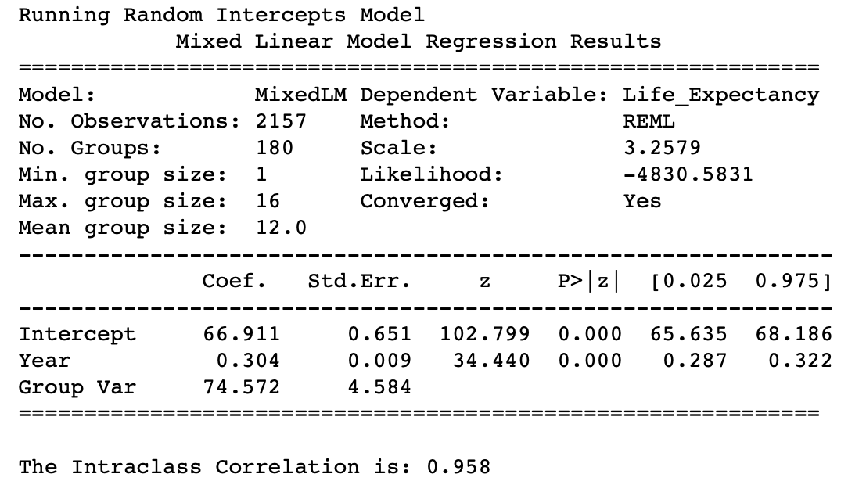
Ri Model results
Iteration | Model | Fixed Effect | RE VAR | RMSE | ICC | Likelihood | LE Min | LE Max | LE Mean | LE Std | LE Var
1 | RI | Year | 74.57 | 1.728 | 0.958 | -4830.6 | 44.5 | 85 | 70.7 | 8.236 | 67.831
2 | RI | Status | 53.18 | 2.189 | 0.911 | -5262.1 | 46.7 | 82.6 | 70.7 | 8.106 | 65.712
3 | RI | Adult_Mortality | 66.82 | 2.181 | 0.928 | -5283.9 | 46.1 | 82.7 | 70.7 | 8.108 | 65.743
4 | RI | Infant_Deaths | 52.16 | 2.045 | 0.92 | -5130.8 | 46 | 82.8 | 70.7 | 8.15 | 66.426
5 | RI | Alcohol | 80.89 | 2.151 | 0.941 | -5269.6 | 46.4 | 84.6 | 70.7 | 8.118 | 65.895
6 | RI | Percent_Expenditure | 71.29 | 2.189 | 0.932 | -5298.9 | 46.7 | 82.7 | 70.7 | 8.106 | 65.704
7 | RI | Hep_B | 69.2 | 2.159 | 0.932 | -5264.7 | 46.1 | 82.7 | 70.7 | 8.115 | 65.859
8 | RI | Measles | 70.55 | 2.161 | 0.933 | -5274 | 46.5 | 83.4 | 70.7 | 8.114 | 65.845
9 | RI | BMI | 68.63 | 2.183 | 0.93 | -5286.1 | 46.4 | 82.6 | 70.7 | 8.108 | 65.734
10 | RI | U_5_Deaths | 48.7 | 1.99 | 0.919 | -5071.5 | 44.2 | 82.7 | 70.7 | 8.166 | 66.687
11 | RI | Polio | 55.73 | 2.067 | 0.923 | -5158.6 | 42 | 82.9 | 70.7 | 8.144 | 66.317
12 | RI | Total_Expenditure | 70.73 | 2.182 | 0.932 | -5285.7 | 45.7 | 83.1 | 70.7 | 8.108 | 65.739
13 | RI | Diphtheria | 54.46 | 2.04 | 0.923 | -5130.3 | 41.5 | 83 | 70.7 | 8.152 | 66.45
14 | RI | HIV_AIDS | 48.83 | 1.99 | 0.919 | -5070.3 | 43.3 | 82.5 | 70.7 | 8.166 | 66.684
15 | RI | Thinness_10_19 | 61.89 | 2.172 | 0.923 | -5264 | 46.1 | 82.6 | 70.7 | 8.111 | 65.793
16 | RI | Thinness_5_9 | 62.43 | 2.179 | 0.923 | -5271.3 | 45.9 | 82.6 | 70.7 | 8.109 | 65.756
17 | RI | Income_Composition | 14.74 | 1.755 | 0.815 | -4710.8 | 43.5 | 84.4 | 70.7 | 8.23 | 67.736
18 | RI | Schooling | 31.7 | 1.91 | 0.889 | -4950 | 44.7 | 84.2 | 70.7 | 8.189 | 67.058
19 | RI | world | 33.89 | 1.913 | 0.895 | -4958.2 | 46.7 | 82.6 | 70.7 | 8.188 | 67.042
2nd best performing model type!
RMSE Range from 1.72 to 2.18.

Slide 39

RS Model results
Iteration | Model | Fixed Effect | Random Effect | RE VAR | RMSE | ICC | Likelihood | LE Min | LE Max | LE Mean | LE Std | LE Var
1 | RS | Status | Year | 0.42 | 3.892 | 0.025 | -6386.5 | 40.3 | 88.9 | 70.7 | 7.319 | 53.572
2 | RS | world | Year | 0.12 | 2.662 | 0.015 | -5521.4 | 44.7 | 85.2 | 70.7 | 7.942 | 63.073
3 | RS | Year | Status | 115.4 | 7.284 | 0.682 | -7413.6 | 67.2 | 83.6 | 70.7 | 4.097 | 16.787
4 | RS | Status | Schooling | 1.83 | 2.001 | 0.295 | -5228.5 | 46.2 | 83.5 | 70.7 | 8.162 | 66.623
5 | RS | world | Schooling | 0.71 | 1.826 | 0.163 | -4964.8 | 45.9 | 83.5 | 70.7 | 8.211 | 67.418
6 | RS | Status | HIV_AIDS | 1493.25 | 2.387 | 0.996 | -5513.7 | 39.2 | 82.5 | 70.7 | 8.041 | 64.663
7 | RS | world | HIV_AIDS | 1205.72 | 2.153 | 0.996 | -5292 | 40.9 | 82.7 | 70.7 | 8.118 | 65.907
8 | RS | Year | HIV_AIDS | 4188.7 | 2.184 | 0.999 | -5435.7 | 38.8 | 84.1 | 70.7 | 8.107 | 65.724
9 | RS | Status | Income_Composition | 2019.54 | 1.778 | 0.998 | -5099.2 | 45.5 | 83.8 | 70.7 | 8.223 | 67.617
10 | RS | world | Income_Composition | 1041.54 | 1.652 | 0.997 | -4897.6 | 46.4 | 83.5 | 70.7 | 8.254 | 68.127
11 | RS | Year | Income_Composition | 299.51 | 1.822 | 0.988 | -4980.6 | 46.3 | 85.3 | 70.7 | 8.212 | 67.437
12 | RS | Status | Alcohol | 35.02 | 3.323 | 0.746 | -6221.8 | 43.7 | 83.8 | 70.7 | 7.652 | 58.548
13 | RS | world | Alcohol | 6.99 | 2.668 | 0.477 | -5654.9 | 44.5 | 84.7 | 70.7 | 7.947 | 63.149
14 | RS | Year | Alcohol | 37.8 | 3.248 | 0.768 | -6186.7 | 42.3 | 88 | 70.7 | 7.689 | 59.115
15 | RS | Status | U_5_Deaths | 4.17 | 2.698 | 0.351 | -5660.2 | 42.5 | 83.6 | 70.7 | 7.949 | 63.194
16 | RS | world | U_5_Deaths | 2.08 | 2.289 | 0.273 | -5282.6 | 43 | 83 | 70.7 | 8.093 | 65.491
17 | RS | Year | U_5_Deaths | 4.74 | 2.977 | 0.335 | -5870.1 | 41.3 | 83.5 | 70.7 | 7.838 | 61.427
Worst performing model type!
RMSE Range from 1.77 to 7.28

Slide 40
Ris model results
Iteration | Model | Fixed Effect | Random Effect | RE VAR | RMSE | ICC | Likelihood | LE Min | LE Max | LE Mean | LE Std | LE Var
1 | RIS | Status | Year | 0.17 | 1.370 | 0.983 | -4641.3 | 41.9 | 85.9 | 70.7 | 8.295 | 68.809
2 | RIS | world | Year | 0.1 | 1.322 | 0.972 | -4532.2 | 42.1 | 85.8 | 70.7 | 8.306 | 68.988
3 | RIS | Year | Status | 15.2 | 1.728 | 0.952 | -4828.5 | 44.5 | 85 | 70.7 | 8.236 | 67.831
4 | RIS | Status | Schooling | 4.73 | 1.654 | 0.996 | -4900.3 | 41.7 | 84.4 | 70.7 | 8.233 | 67.784
5 | RIS | world | Schooling | 2.56 | 1.542 | 0.994 | -4696.9 | 42 | 84.1 | 70.7 | 8.263 | 68.279
6 | RIS | Status | HIV_AIDS | 7.15 | 1.877 | 0.885 | -5010.1 | 43.4 | 82.6 | 70.7 | 8.188 | 67.05
7 | RIS | world | HIV_AIDS | 2.72 | 1.747 | 0.881 | -4830.6 | 43.6 | 82.6 | 70.7 | 8.225 | 67.646
8 | RIS | Year | HIV_AIDS | 1.45 | 1.578 | 0.952 | -4687.5 | 43.7 | 84.6 | 70.7 | 8.266 | 68.33
9 | RIS | Status | Income_Composition | 3337.96 | 1.572 | 0.998 | -4761.4 | 42 | 84.5 | 70.7 | 8.257 | 68.177
10 | RIS | world | Income_Composition | 1992.35 | 1.483 | 0.998 | -4596.4 | 42.4 | 84.1 | 70.7 | 8.279 | 68.541
11 | RIS | Year | Income_Composition | 1524.9 | 1.485 | 0.997 | -4634.5 | 41.7 | 85.3 | 70.7 | 8.277 | 68.516
12 | RIS | Status | Alcohol | 0.73 | 1.993 | 0.933 | -5199.1 | 45.3 | 83.6 | 70.7 | 8.148 | 66.387
13 | RIS | world | Alcohol | 0.45 | 1.767 | 0.929 | -4919 | 45.4 | 83.3 | 70.7 | 8.213 | 67.46
14 | RIS | Year | Alcohol | 0.54 | 1.587 | 0.966 | -4783.2 | 43.7 | 84.8 | 70.7 | 8.257 | 68.184
15 | RIS | Status | U_5_Deaths | 0.88 | 1.717 | 0.903 | -4921.5 | 43.2 | 83.1 | 70.7 | 8.228 | 67.703
16 | RIS | world | U_5_Deaths | 0.37 | 1.606 | 0.896 | -4740 | 43.4 | 82.9 | 70.7 | 8.257 | 68.178
17 | RIS | Year | U_5_Deaths | 0.28 | 1.497 | 0.944 | -4643.1 | 42.6 | 84.5 | 70.7 | 8.281 | 68.582
Best performing model type!
RMSE Range from 1.32 to 1.99.

Slide 41


Model results
Residual histogram
The incremental difference between developing and developed is 11.3 years with an average of 71.5 years. Year doesn’t vary all that much.
Shapiro Wilk: (0.7576553225517273, 0.0)

Slide 42




Model results
Between Variance
Residual

Slide 43


findings
Method | RMSE | R²/ICC | LE Min | LE Max | Mean LE | LE Std | LE Var
Gradient Boosting | 1.688 | 0.9601 | 42.0 | 85.0 | 70.7 | 8.147 | 66.366
RIS | 1.370 | 0.983 | 41.9 | 85.9 | 70.7 | 8.295 | 68.809
Data | - | 1 | 41.0 | 89.0 | 70.7 | 8.447 | 71.356

Slide 44
Takeaways
Developed | Developing | 1st World | 2nd World | 3rd world | Xtrain | X | AVG
Adult Mortality | HIVAIDS | Adult Mortality | Adult Mortality | Adult Mortality | Income Composition | Income Composition | Income Composition
Income Composition | Income Composition | Income Composition | Income Composition | HIVAIDS | HIVAIDS | HIVAIDS | Adult Mortality
Thinness 5-9 | Adult Mortality | Thinness 10-19 | Schooling | country_code | Adult Mortality | AdultMortality | HIVAIDS
TotalExpenditure | Schooling | Year | HIVAIDS | Income Composition | Schooling | Thinness 5-9 | Schooling
Alcohol | Polio | Schooling | Thinness 5-9 | U-5 Deaths | Thinness 5-9 | U-5 Deaths | Thinness 5-9
Life Expectancy Ranges:
Developed :70 to 89
Developing: 41 to 86 years
1st World: 78 to 88 years
2nd World: 65 to 78
3rd World: 41 to 65
The developed and developing status don’t fully cover the different categories of countries.
Testing Data averaged much higher across all groupings than the training groups. Most generally, life span is increasing every year about .3 years of added life.
Disease and hunger relief are an universal key to improving life expectancy globally.
Mixed Models are effective , but still need to keep improving.

Slide 45
Future work
Look at class within a particular country and see if these same factors are same in determining life expectancy for an individual.
Use the Twitter API to incorporate NLP analysis for a country to see how it relates to Life Expectancy.
Increase the dataset size with continuing UN and Global Data to incorporate new added features like population, GDP, environmental, and etc in order to test and clarify country groupings.
Mental Health versus Life Expectancy

